Slide 1

The Future of the Network is Autonomous
Min He 3/19/2021

Slide 2
Outline
Why Autonomous Networks?
The Autonomous Networks
Vision, Framework, Key Concepts and PoC
Refactoring Networks for Autonomy
Call for XXXX to Join Industry AN Initiatives
Summary

Slide 3



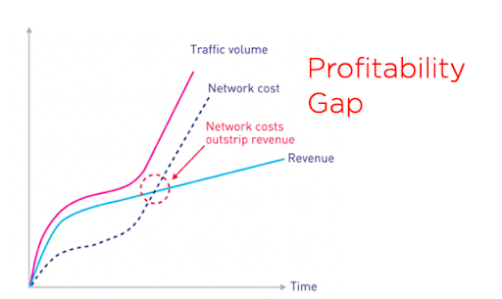
What Drives the Fundamental Shift of Digital Technology?
Unlimited Computer Power in the Cloud
Data
Ubiquitous Connectivity
Great, But CSPs have the problem

Slide 4
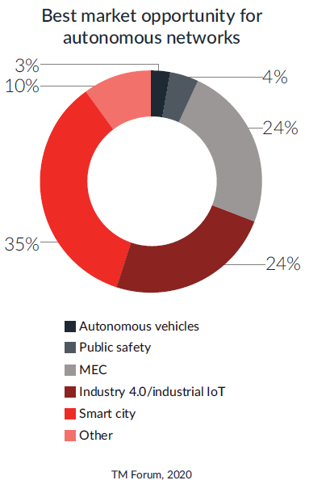
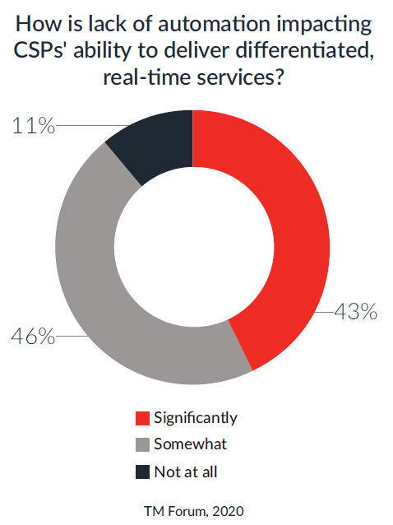
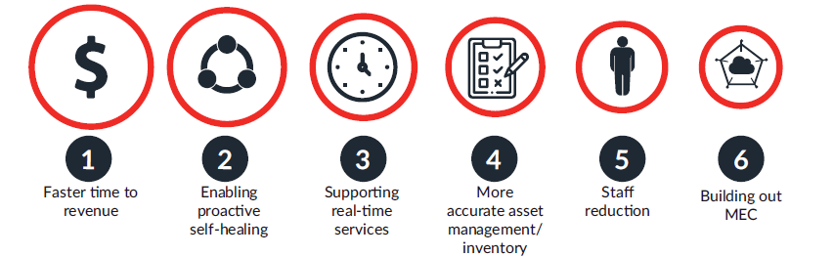
CSP Digital Transformation Demands New Paradigm of Thinking
Diversified Demands of Network Services
Level of Consensus
CSP Role
Transformation
Connectivity
Provider
Network Service
Provider
Digital Service
Provider
CSP Business Model
Transformation
Connectivity business
Platform business
Agile
IOT
CSP Operation Model
Transformation
CT Ops
IT Ops
Sec Ops
ICT Ops
Sec Ops
AI ICTS ANOps
5G/F5G
Cloud/Edge
Transformation Path
?
2B is the New Business Growth Point
Automation is the Foundation of
Digital Service
Both Revenue Growth and Cost Saving are the Drivers for AN but Revenue Growth Plays More Prominent Role
intelligent
AI/ML
Open
Complex Network and Compute Resources Environment

Slide 5
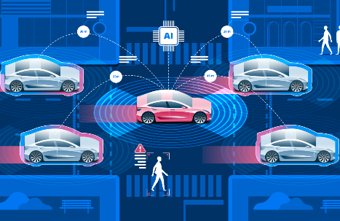
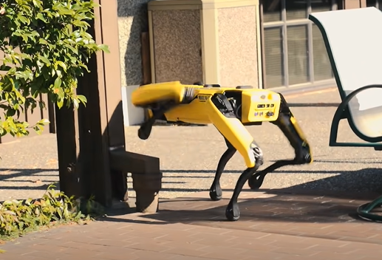
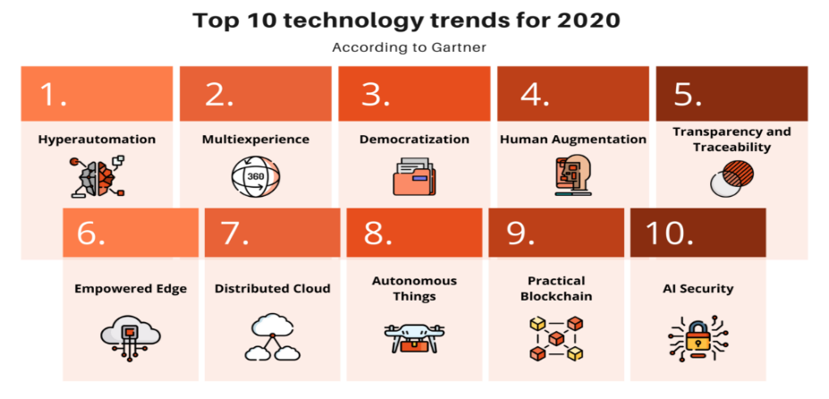


Autonomy is the Key to Achieve Ultra-automation
Traditional automation can only deliver 10%-20% improvement.
Autonomous technology is the technology that can deliver the need of ultra-automation. An autonomous system
observes its environment continuously
analyzes environment stimulus
makes decision based on the intent, input Data and knowledge
executes the decision automatically
Ultra-Automation seeking 10X improvement in operational costs, capital costs, rate of new services introduction, scalability and customer experience.
efficient gain
10x
Autonomous technology can deliver the ultra-automation
time
Ultra-automation requires continuously automate precision decision that can close business loop at scale in complex, ever-changing business environment.
“The Autonomous Decade”

Slide 6
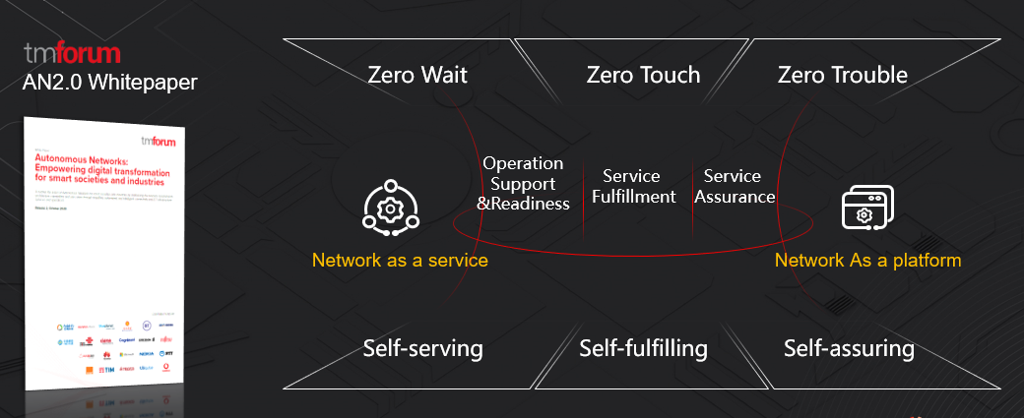
Autonomous Networks (AN): Telecom Industry’s Grand Vision
Deliver Zero-X Experience Through Self-X Capabilities
Provide fully automated Zero-X (zero wait, zero touch, zero trouble) innovative, critical network/ICT services for vertical industries users and consumers, and
Support Self-X (self-serving, self-fulfilling and self-assuring) network/ICT infrastructures and services for enabling digital transformation of vertical and telecom industries through full lifecycle of operations
Offer disruptive services for innovative user experience, mission critical services based on fully automated lifecycle operations and self-organizing, dynamic optimized resource
Comprise of simplified network architecture, virtualized components, automating agents and intelligent decision engines to create intelligent automated business/network operations for the closed-loop of new digital business

Slide 7
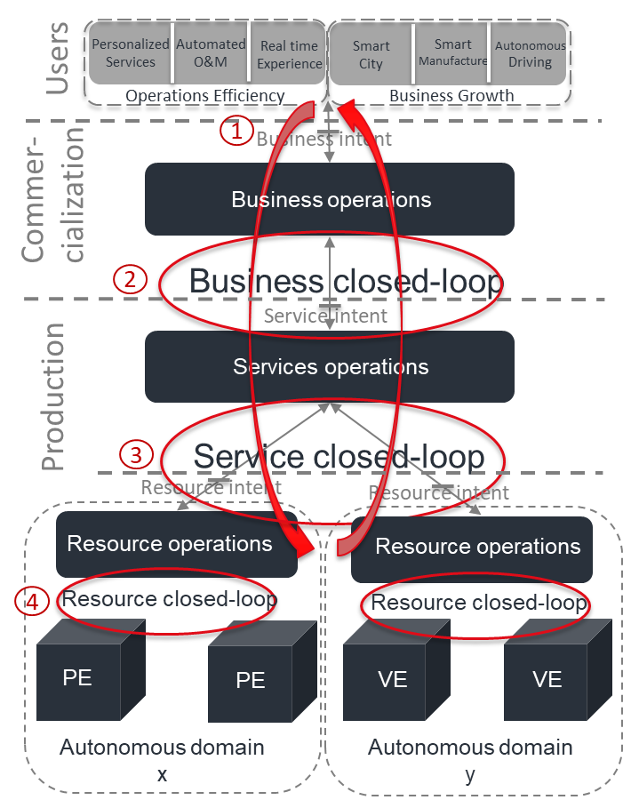
TMF Autonomous Networks Framework
3-layers: Are common capabilities that can be utilized to support all scenarios and business need
Network resource layer
Network operations layer
Business operations layer
4-closed-loops: to fulfill the full lifecycle of the process
Resource closed loop
Service closed loop
Business closed loop
User closed loop
Key mechanisms: to enable closed loop
Autonomous domain
Intent driven interaction and open APIs
Metadata modelling and abstraction
NaaS
Source: TM Forum “Autonomous Networks Whitepaper Release 2”

Slide 8
Autonomy Levels of AN
Level 0 - Manual management | The system delivers assisted monitoring capabilities, which means all dynamic tasks have to be executed manually.
Level 1 - Assisted management | The system executes a certain repetitive sub-task based on pre-configured to increase execution efficiency.
Level 2 - Partial autonomous network | The system enables closed loop O&M for certain units based on the AI model under certain external environments.
Level 3 - Conditional autonomous network | Building on L2 capabilities, the system with awareness can sense real-time environmental changes, and in certain network domains, optimize and adjust itself to the external environment to enable intent-driven closed loop management.
Level 4 - High autonomous network | Building on L3 capabilities, the system enables, in a more complicated cross-domain environment, analyze and make decisions based on predictive or active closed loop management of service and customer experience-driven networks.
Level 5 - Full autonomous network | This level is the end-goal for telecom network evolution. The system possesses closed loop automation capabilities across multiple services, multiple domains, and the entire lifecycle, achieving autonomous networks.
Autonomous Levels | L0: Manual Operation & Maintenance | L1: Assisted Operation & Maintenance | L2: Partial Autonomous Networks | L3: Conditional Autonomous Networks | L4: High Autonomous Networks | L5: Full Autonomous Networks
Execution | P | P/S | S | S | S | S
Awareness | P | P | P/S | S | S | S
Analysis | P | P | P | P/S | S | S
Decision | P | P | P | P/S | S | S
Intent/ Experience | P | P | P | P | P/S | S
People (manual) Systems (autonomous)
P
S
Source: TM Forum “Autonomous Networks Whitepaper Release 2”

Slide 9















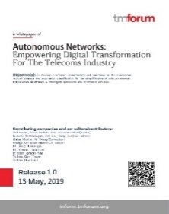
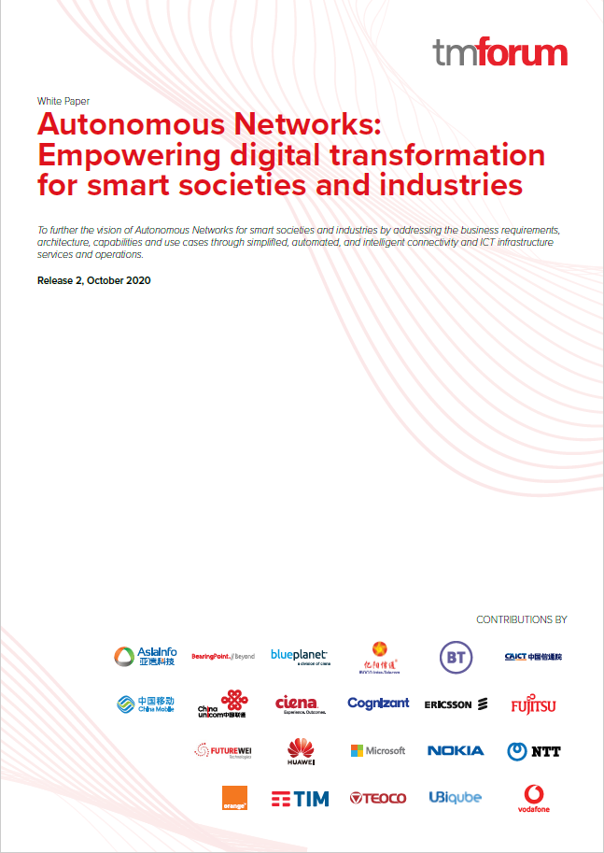








Industry Consensus Building ： From Concept to SDO Collaboration
2017.02
2019.05
2019.08
2019.8
2019.09
2019.10
2020.02
2020.05
2020.06
2020.10
ENI
work group
AN R19
white paper
MBB intelligence classification
AN architecture specifications
AI in Network
report
Network intelligence grading standards
AN Business Architecture
F5G E2E Mgmt.
& Ctrl. initiation
R17 AN grading standards Initiation
AN R20
Cross-SDOs workshop
Concept
Top-Level Architecture & Scenarios
Technical Architecture & Level Definition
Collaboration
商业自动化
Biz.
Customer, Partner and Ecosystem
Autonomous network
Working Group
Service
Network Service Operations
Autonomous
Networks
Resource Operation
Resource Operation
Network
NE
NE
VNE
VNE
R19 Whitepaper:
6 company
9 Contributors
R20 Whitepaper:
22 company
41 Contributors
Autonomous
Domain X
Autonomous
Domain Y
Cross-SDO alignment and collaboration

Slide 10
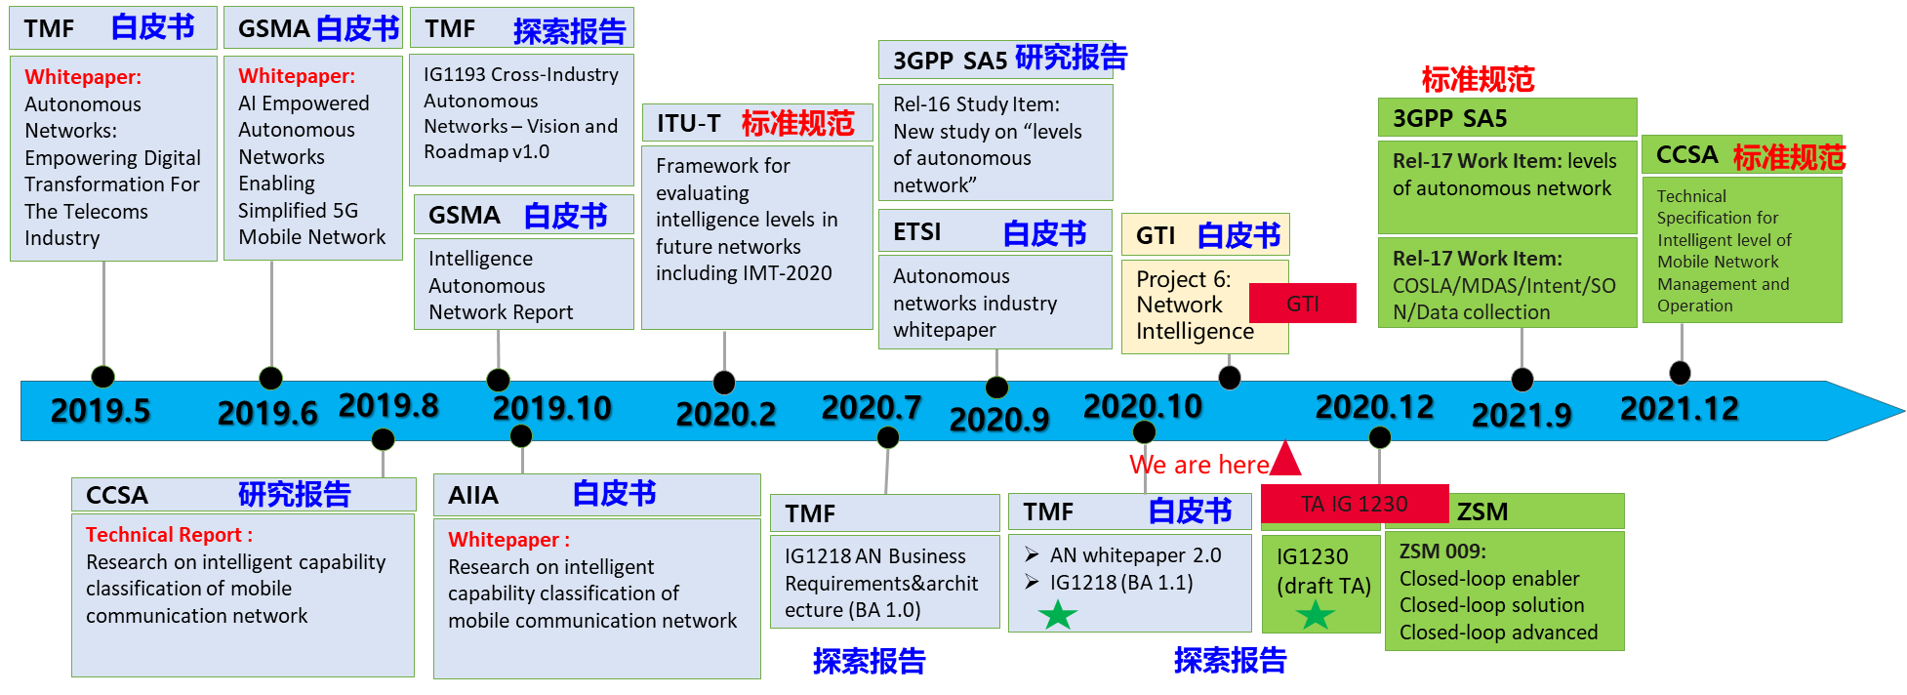
SDOs in Action
WP
WP
Report
Report
Standard
Standard
Standard
WP
WP
WP
Report
WP
WP

Slide 11
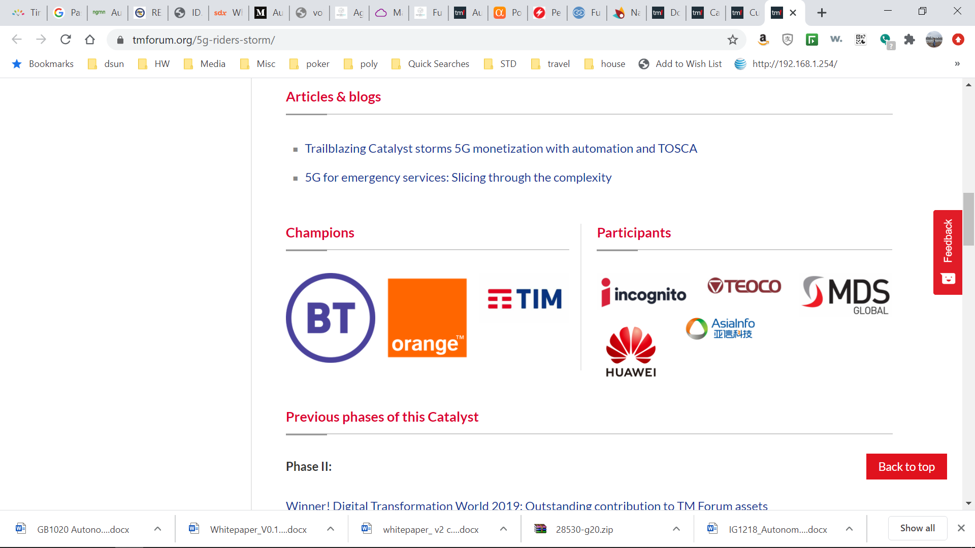
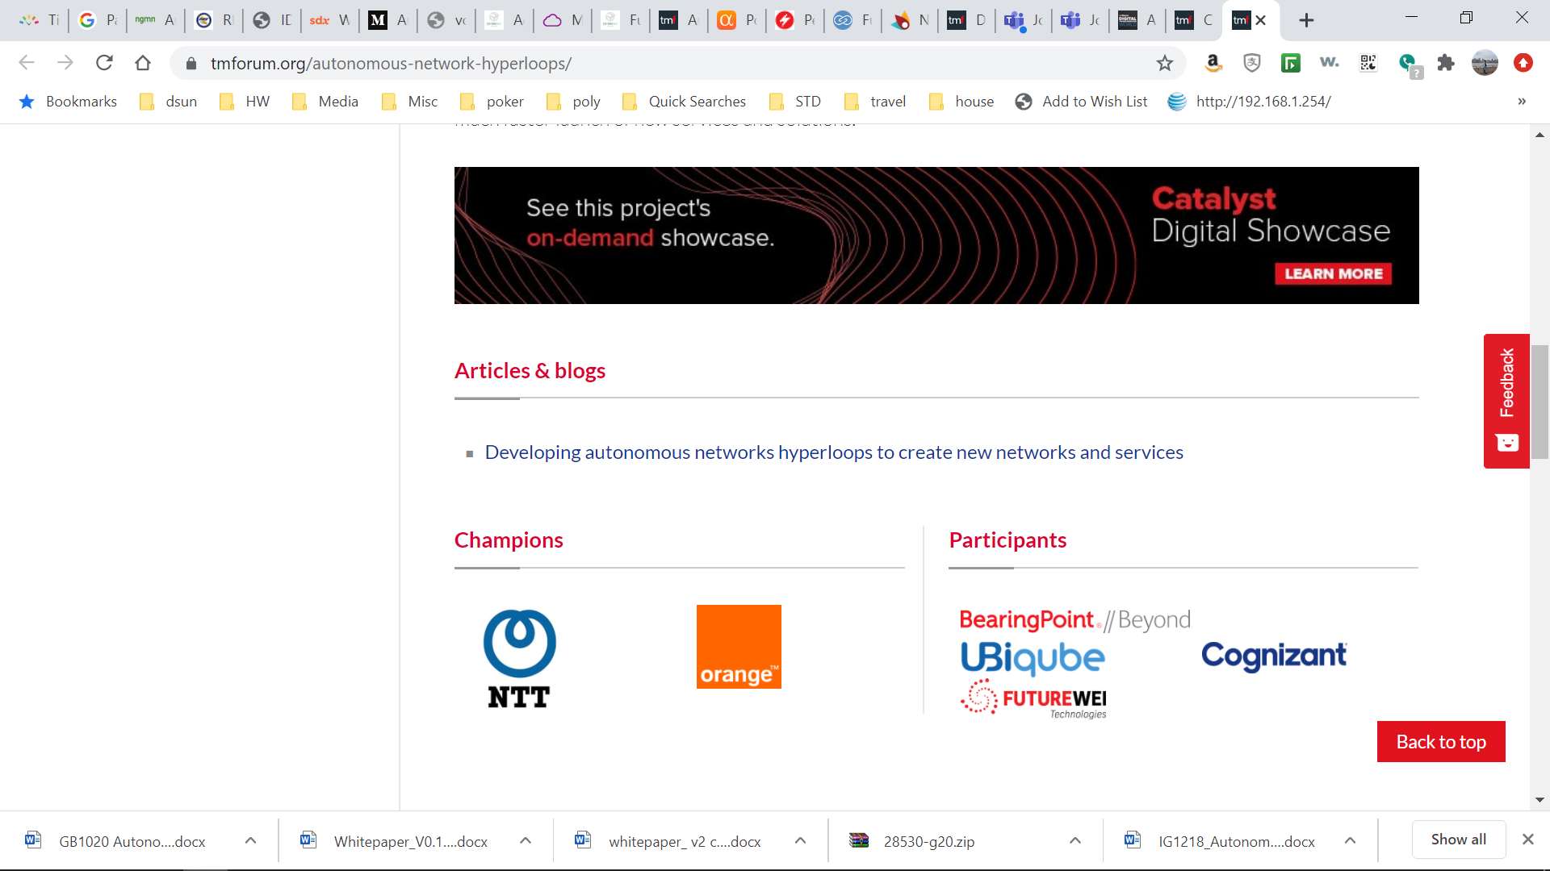



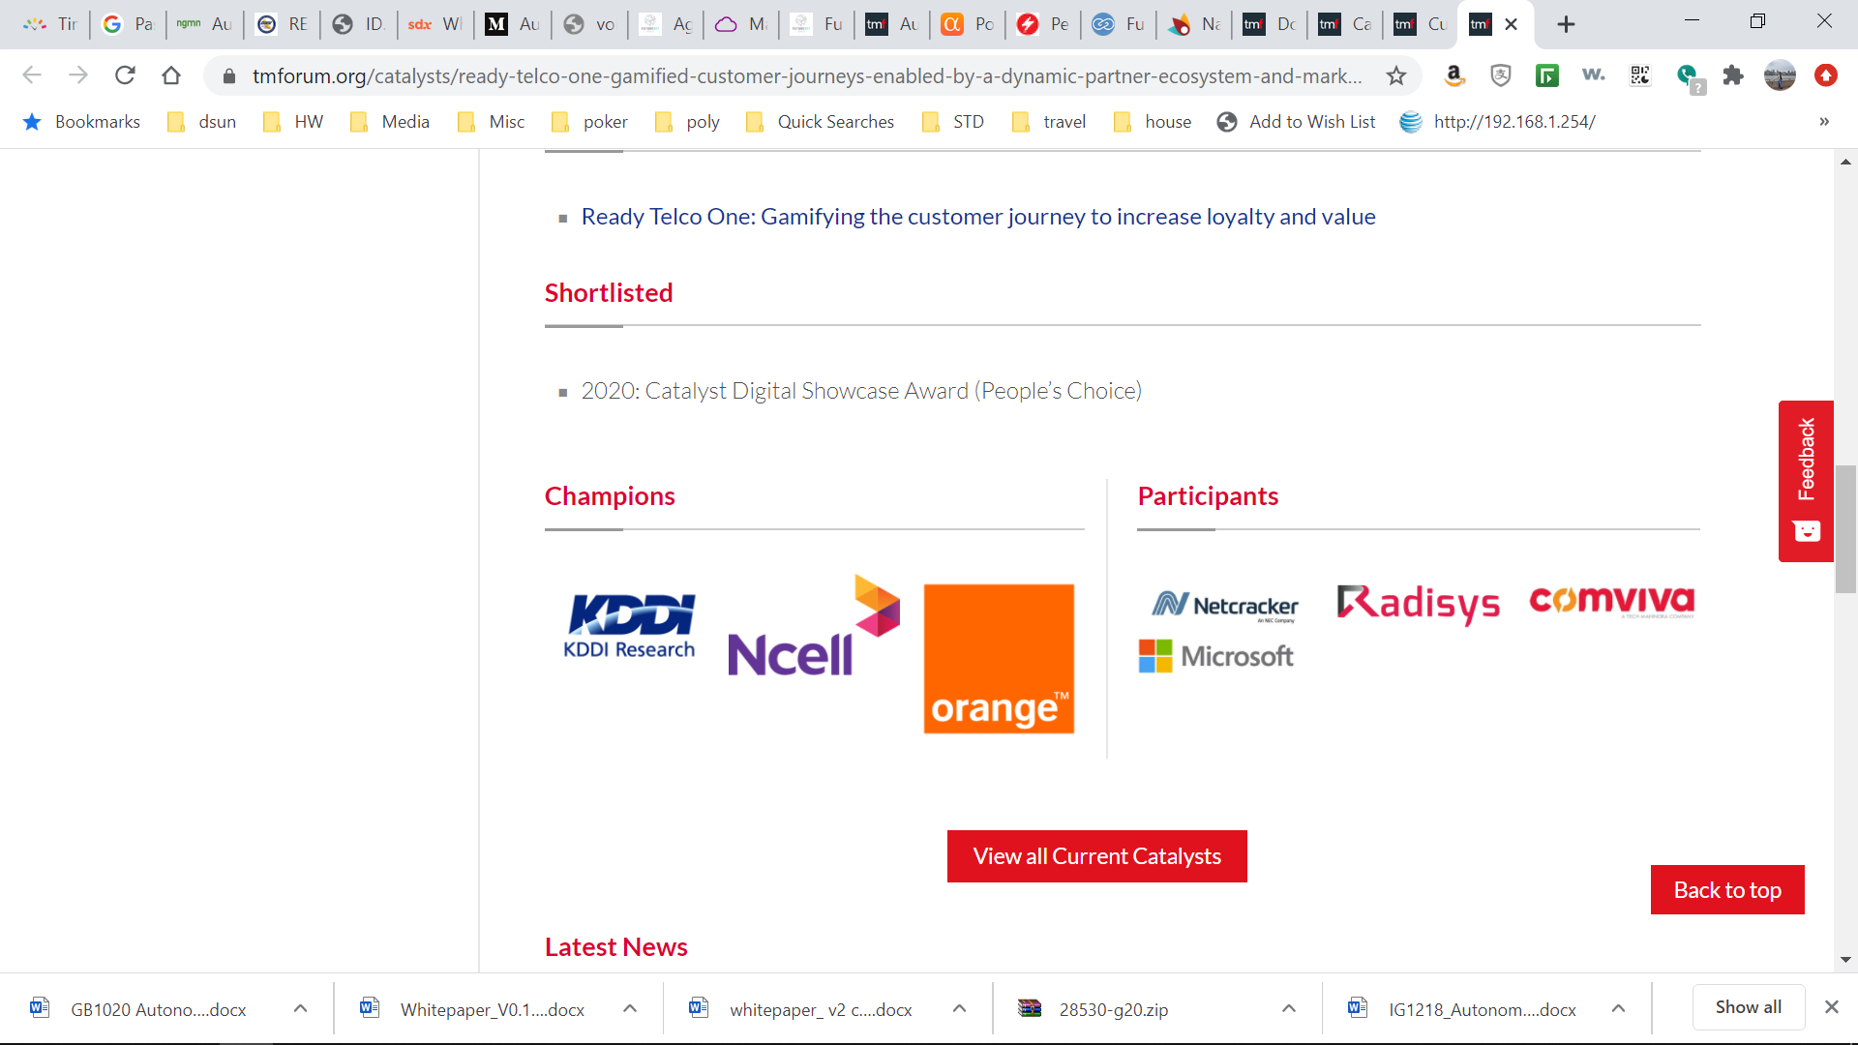
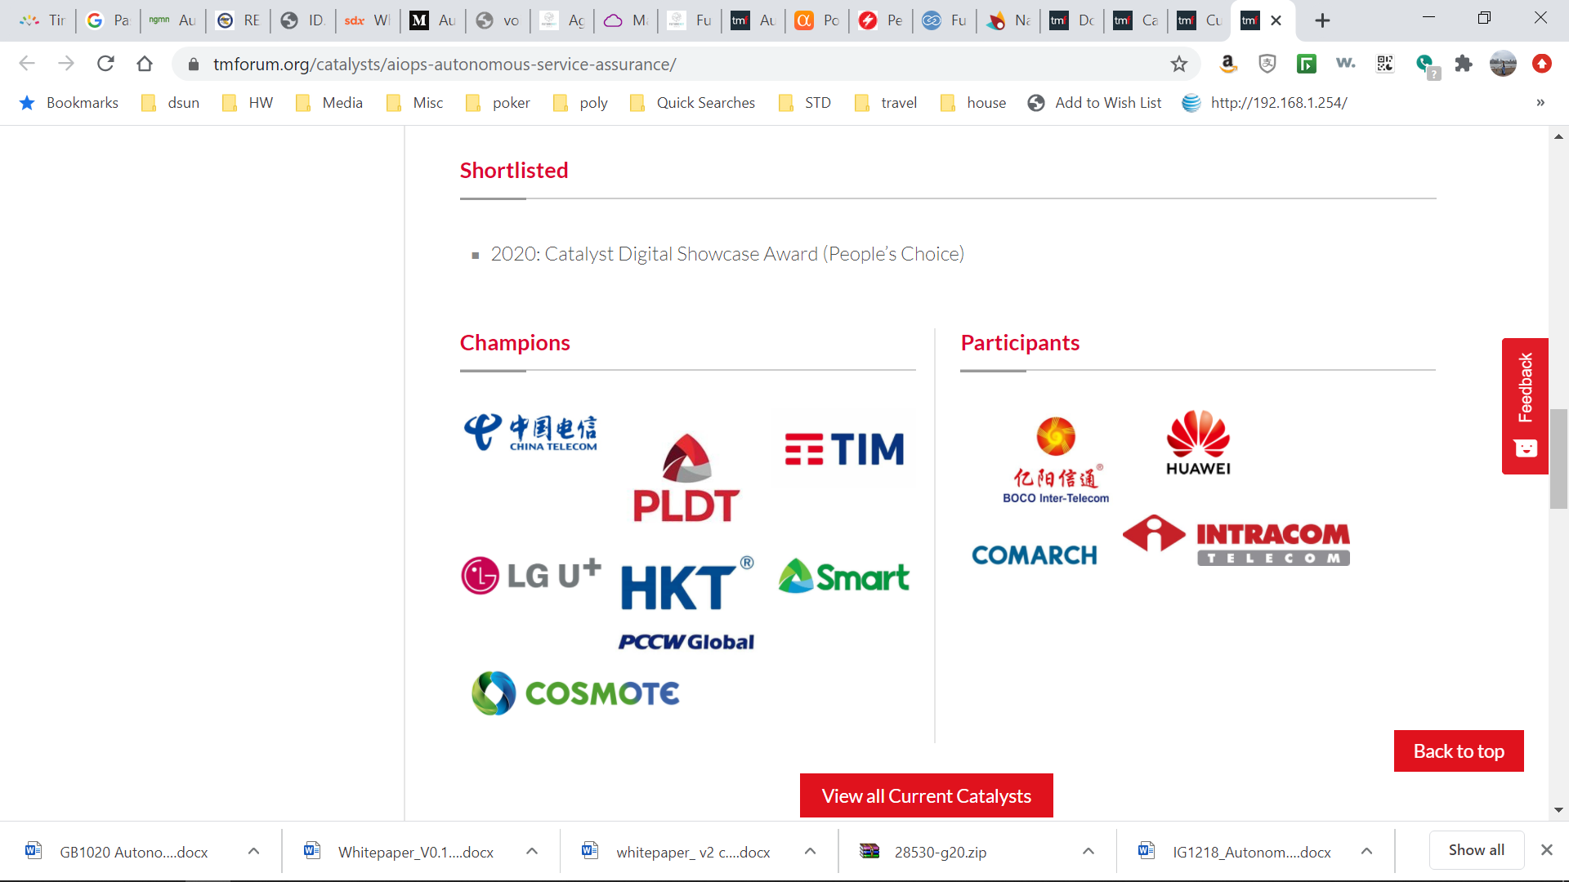
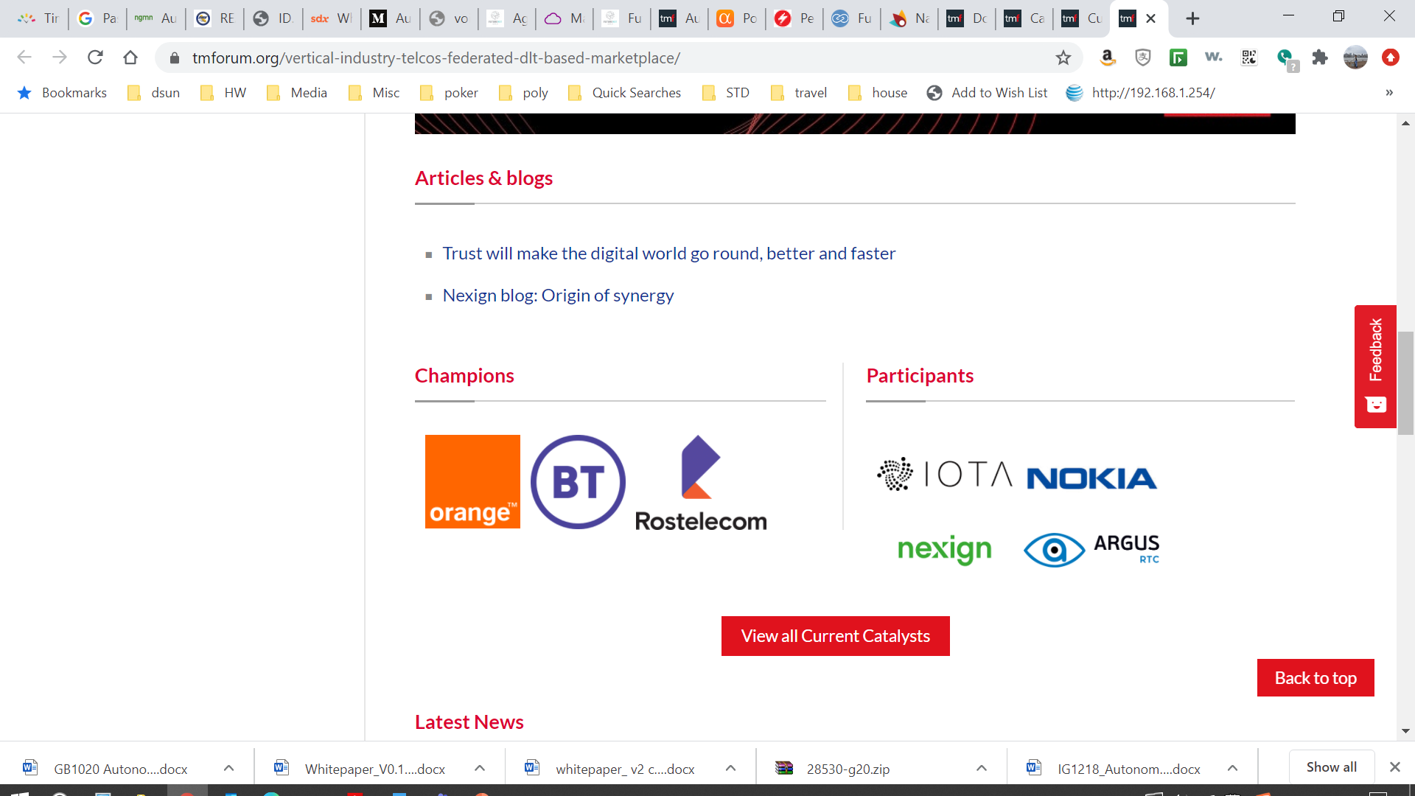
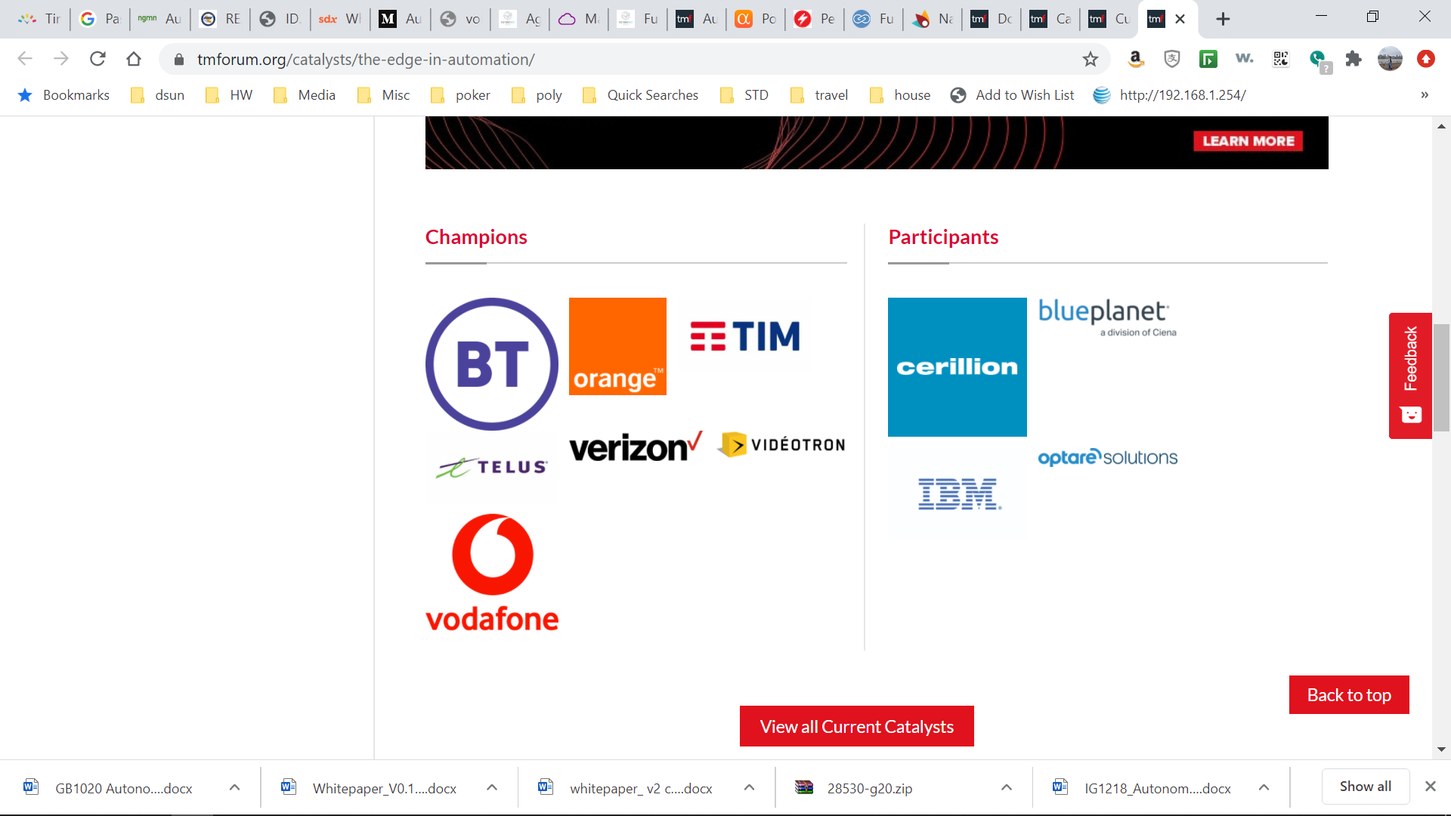
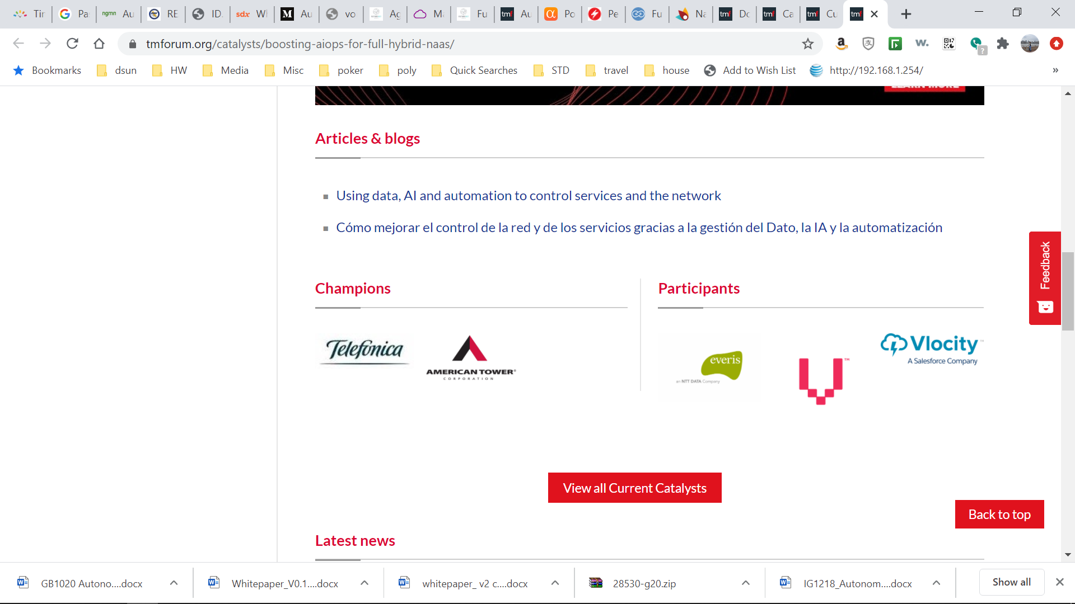
TM Forum Autonomous Network Catalyst Projects
10 Projects, 60+ Companies
5G Ride On!
ANHL for Smart-X verticals
AI empowered 5G intelligent operations
Smart networks for smart cities
Ready Telco One: Gamified customer journeys enabled by a dynamic partner ecosystem and marketplace!
AI for AN: Accelerating digital transformation in 5G era
AIOps autonomous service assurance
Vertical Industry Telcos: a Federated DLT-based Marketplace
The “EDGE” in Automation
Boosting AIOps for full hybrid NaaS

Slide 12





AN Catalyst Project Example 1: Autonomous Networks Hyperloop
New Business Opportunity Focus
Top-Down Approach
This Catalyst project is demonstrating how to enable a zero-X customer experience and improved operational efficiency for B2B companies and digital service providers in key Smart-X industries, such as cities, entertainment, manufacturing, healthcare and agriculture. They use disruptive “self operating” services and infrastructures based on an Autonomous Networks framework driven by business intent to resource intent.
Champions:
Participants:

Slide 13
Selected Vertical and the Business Scenarios
Smart Manufacturing
Smart Healthcare
Smart Cities
Smart Automotive
Smart Entertainment
Large scale M2M & IoT deployment
Robotic surgery
Self-sustainable urban ecosystem
Self-driven vehicles
Autonomous media, & gaming systems
Smart Energy
Smart Tourism
Smart Education
Smart Mobility
Automated Grid failure Management
Tourists visiting an art gallery experience AR view of an art of interest on their mobile
Interactive, digital & AR enabled services for interest based remote learning
Automated guided car parking & integrated billing
Smart Security
Smart Waste Mgt.
Smart Environment
Smart Infrastructure
Minimizing risk for police or fire rescue officers in uncertain or dangerous situations
Just In Time waste collection by tracking waste levels & providing route optimization
Soil moisture level detection & automated Sprinkler system based on type of plant
Autonomous monitoring and maintenance of street lighting networks remotely
LEGEND →
Self Config/ZTP
Auto Scaling
AI Assistance
Predictive Maintenance/Self Healing

Slide 14
AN Hyperloop: A Multi Year Catalyst Explores the New Business Opportunities Enabled by Autonomous Networks
.
Continuous catalyst
(Scenario, architecture, PoC, and specifications)
The foundations
Overall design, select one scenario /capabilities = IoT for SC
The enhancements
Architecture proposal, New domains , closed loops
The maturity
Global technical and business E2E closed loop (Level 3~4)
Phase 1 : L2/3(~2020)
Phase 2： L3(~2021)
Phase 3： L3/4(~2022)
Phase 1.1 (June & oct2020, DTW):
- Overall blueprint design
- scenario: Smart city/IoT
- capabilities: real time, dynamic resource mgt. of edge (+ 5G) w/ AI at L2/3 / overall draft architecture
Phase 1.2 (Nov 2020, DTA):
- Refine overall blueprint design
- Simple mockup for selected scenarios: a) Smart city/IoT, b) one more vertical
- capabilities: cont’d
Phase 2.1 (June 2021, DTW):
- Refine overall blueprint design
- scenarios: a few more verticals (e.g. energy, manufacture)
- capabilities: adding more (e.g. BO/SO for closed loop w/ scenarios at L2/3)
Phase 2.2 (Nov 2021, DTA):
- Define initial prototype for a real use case
- scenarios: a few more verticals aligned w/ the prototype
- Define processes & architecture as final framework, ID capacities &capabilities
Phase 3.1 (June 2022, DTW):
- Final blueprint design
- Vertical implementations scenarios & framework
- Global capabilities definition : E2E closed loop at L3/4
Phase 3.2 (Nov 2022, DTA):
- Global prototype & implementation in real case
- Select scenarios for the implementation ( healthcare, entertainment ? )
- Demonstrate capabilities L3/4

Slide 15




AN Catalyst Project Example 2: AI Empowered 5G Intelligent Operations
Operation Efficiency Focus
Bottom-up Approach
This Catalyst will explore the application of artificial intelligence (AI) technology for network planning, construction and maintenance in order to improve: the utilization of network resources; network operation and maintenance efficiency; customer experience; and energy usage, and to optimize OpEx for telecom operators.
Champions:
Participants:

Slide 16
Scenarios of Service Assurance Based on Data-Driven Intelligent, Critical Stepstone Toward Self-Healing
Premium home broadband
AI-driven comprehensive improvement of network satisfaction
4G/5G intelligent incident management
NFV log analysis
Resource Layer
Service Layer
Business Layer
Intelligent mining of mass data helps detect hidden risks, locate the root causes of alarms, and intelligently preprocess faults, improving O&M efficiency.
Intelligent analysis of performance indicators helps proactively identify and automatically process poor-quality services, improving network quality.
Intelligent modeling based on home network characteristics and customer intents helps accurately identify and solve customer complaints, improving customer experience.
Effect
Effect
Effect
Alarm compression rate: 99.9%; tickets: reduced by 35%
Risk monitoring scope ↑
More comprehensive device risk monitoring, preventing major risks from being missed
Auxiliary measures for alarms and traffic statistics
Risk detection speed ↑
1-30 minutes earlier than alarm generation
Device security ↑
Prevent faults in advance
Keep network devices secure
Efficiency Improvement↑
Call center In-time answer rate 70%
resolution is available within 3 seconds。
Accuracy Improvement↑
Root cause accuracy > 85%
Locating accuracy > 95%
Proactive Enhancement↑
Overall user satisfaction evaluation is proven with 92% accuracy
Prevent complaints from high potential users
95%
90%
Recall: 95%;
precision: 90%
Recall
Precision
Notes:
China Mobile vigorously promotes ADN research and practices, while also using AI technologies to improve O&M efficiency, network quality, and service agility.
Intelligent mining of mass data helps detect hidden risks, locate the root causes of alarms, and intelligently preprocess faults, improving O&M efficiency.
Intelligent analysis of performance indicators helps proactively identify and automatically process poor-quality services, improving network quality.
Intelligent modeling based on home network characteristics and customer intents helps accurately identify and solve customer complaints, improving customer experience.

Slide 17
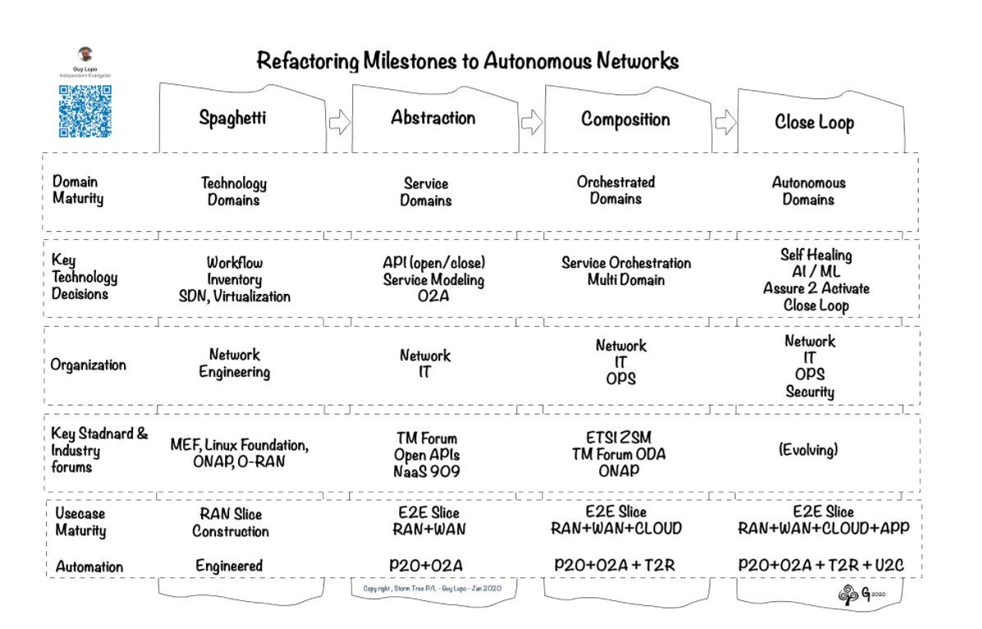
Refactoring Network to Autonomy
Infrastructure
Virtualize network devices and functions
Make network programmable
Add AI capability at device and function level
Data
Data availability should be one of the central considerations when design new network functions
Ability to instrument the data collection parameters directly on the data source
Abstraction
Configuration task is abstracted away from network management
Abstract business requirement and operational policies
Abstract the service monitoring from fixed metrics to service-oriented indications
Managing Automation
Operational staff move from managing the network devices to managing the automation process
Existing script-based, prescribed automation cannot handle unexpected situations
Operational staff will provide the boundary conditions and let network intelligence to evolve within the set boundaries.
NaaS
Guy Lupo, Head of Orchestration & Data 2020, Telstra
Source: http://www.stormtree.biz/2020/02/04/network-refactoring-roadmap-matrix/

Slide 18
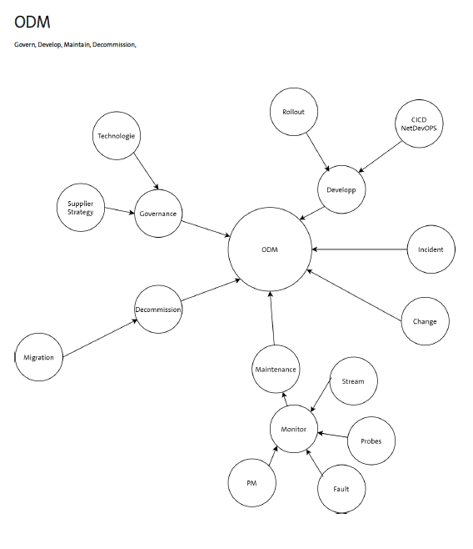


Evolve Traditional Network Management and Control Platform to Autonomous Domain
Characteristics of
Autonomous Domain
Self-x capabilities: Autonomously take proper actions upon the user intent or environment changes
Self-Config
Self-Healing
Self-Optimize
Self-Protect
Self-Learn
..
Intent based interface: State what you want instead how to do.
Business Intent
Network Service Intent
Resource Intent
Superior user experience:
10x more efficiency gain.
Zero-touch
Zero-wait
Zero-trouble
Zero-trust
Zero-friction
Single Domain Autonomy, Multi Domains Collaboration
Business
Autonomous Domains Orchestrators
Autonomous Domains
Managed Resources
human
applications
Self-x
Self-x
Self-govern
Self-config
Orchestrating within a discipline
Orchestrating cross disciplines
Autonomous Domain
Self-verify
Self-healing
Self-config
Self-x
Self-protect
Self-config
Knowledge
source
Self-healing
Self-config
Self-optimize
RAN
FAN
Optical
IP
Core
Intent
based HMI
Intent
based MMI
Cognitive closed loop:
Monitor, Analyze, Plan, Execute

Slide 19
Compare Traditional Network Management System with Autonomous Domain
 | Traditional Network | Autonomous Domain
Loop Closure | Open-loop management Human in the loop Manual closure | Closed-loop Human on the loop Supervision and audit closure
Behavior | Execute functions Human makes decision | Execute intents Aware of environment change Cognitive, system makes decision
Interface | CLI GUI Limited device technical interfaces | Intent-oriented machine-machine interfaces(MMI) and human-machine interfaces(HMI)

Slide 20

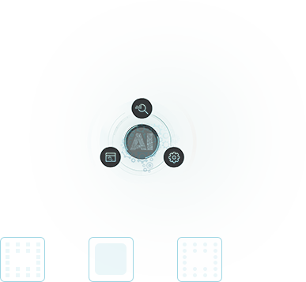



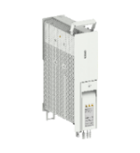
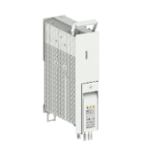
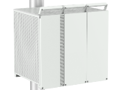



Ultra-Automation as a Major Driver for AN in NetX2025 GUIDE Strategy
GUIDE
Ultra-Automation
Gigabit Anywhere
Intelligent Multi-cloud Connection
Differentiated Experience
Environmental Harmony
Differentiated Experience
Access
Telco Cloud
Multi-Cloud
E2E SRv6
5G to Digital Vertical
Edge
Telco VAS
Sovereign cloud
Self-Operated
…
Intelligent Multi-cloud Connection
Gigabit Anywhere
Slice
Slice
Slice
Intelligent O&M
OptiX SuperSite
Cloud Core
Transport
Heterogeneous Computing
10Gbps to Home
CPU
GPU
FPGA
FTTr
10Gbps
Flex PON
WIFI6
Partner
MEC
IP Fabric
…
Gbps to Consumer
Fiber 200G/400G OTN
RuralStar
Super
Blade Site
Ultra-Automation
Environmental Harmony

Slide 21
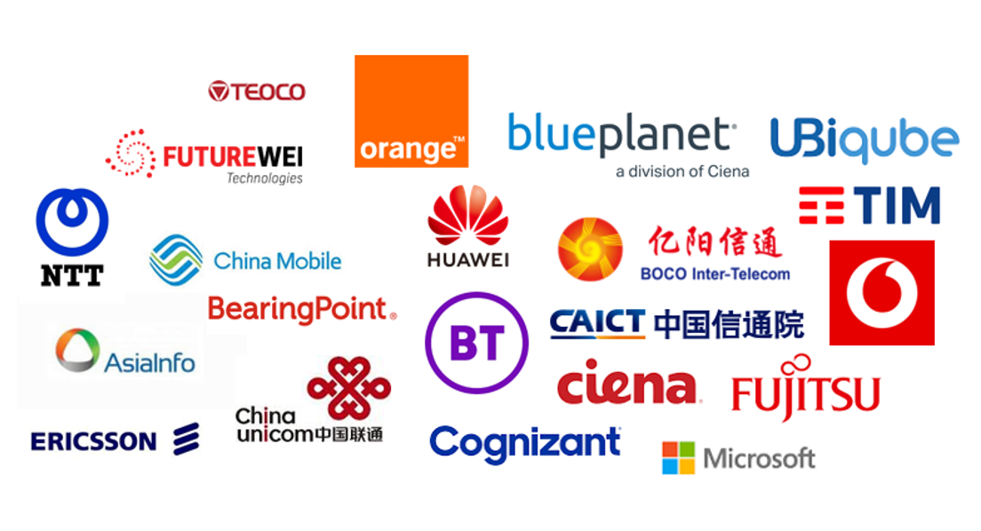

Call for XXXX to Participate into Industry Autonomous Networks Initiatives
Join TMF Autonomous Network Project
1
2
3
Define a hierarchical measurement system
Define an autonomous network reference architecture
Define the critical use cases and scenarios
Unified technical and architectural languages. Technical perspective, define the medium- and long-term autonomous network reference architecture, to ensure architectural stability and advanced.
Determine use cases that bring most value The priority of closed-loop scenarios, business process innovations, new product development scenarios, human and system interaction efficiency
Determine the assessment and measurement system. Production and delivery perspective, can measure landing, guide production practice activities.

Slide 22
Summary
The Business Need drives Autonomous Networks.
The Industry Aligns on Autonomous Networks Vision.
CSPs, Standard Bodies, Vendors Are Joining Force to Define AN in Details with PoCs to Verify the Concepts and Approaches.
XXXX’s Active Participation will Expedite XXXX’s Digital Transformation Process and Benefit the Industry as a Whole.

Slide 23
Thank You

